Slide 1
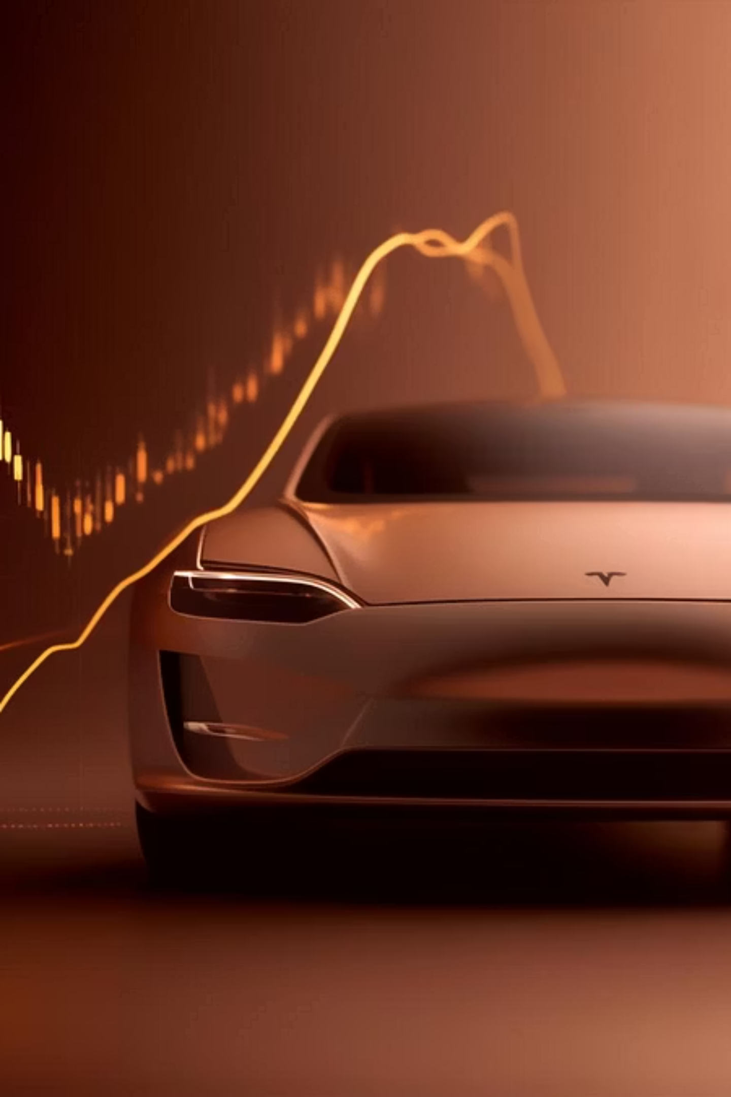
Tesla Stock Prediction
Understanding Stock Behavior with Data

Slide 2
Why This Project?
1
2
Market Volatility
Data Exploration
Tesla is a highly dynamic and frequently analysed stock globally.
A deep dive into real-world stock price behaviour using Python.
3
4
Financial Insight
AI Foundation
Blends data analysis with practical financial market understanding.
Sets the stage for advanced AI-driven stock prediction models.

Slide 3
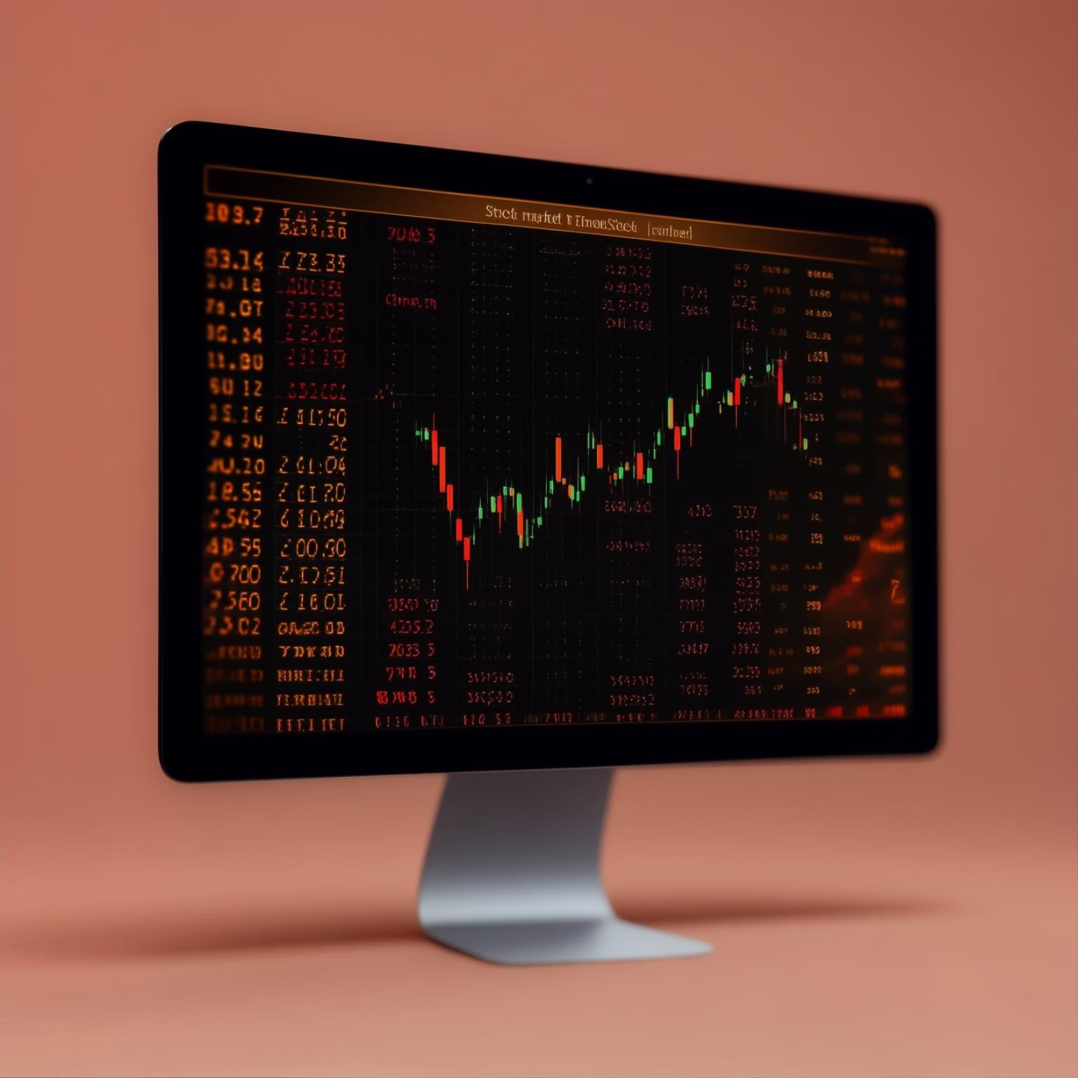
Data Utilised for Analysis
1
Historical Stock Data
Collected extensive historical Tesla stock data in CSV format.
2
Key Financial Fields
Focused on Date, Open, Close, High, Low, and Volume.
3
Data Cleaning
Pre-processed data, addressing missing values and inconsistencies.
4
Quality Assurance
Ensured data integrity before commencing any analytical work.

Slide 4



Core Explorations
Closing Price Trend
Daily Returns
Return Distribution
Analysed the stock's movement over extended periods.
Calculated daily percentage gains or losses to gauge performance.
Examined the frequency of specific return values.
These explorations provided a comprehensive understanding of Tesla's stock performance and market volatility.

Slide 5

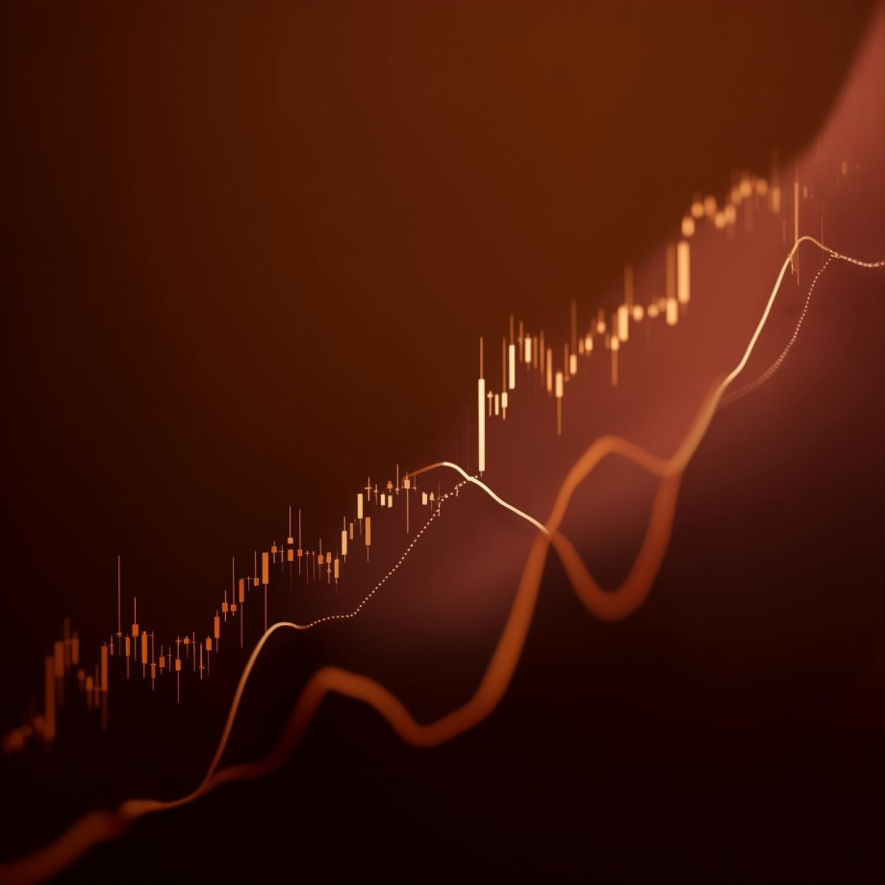

Key Visualisations
Line graph: Tesla’s closing price over time.
Plot: Daily return fluctuations, highlighting market volatility.
Histogram: Distribution of daily returns, revealing common ranges.

Slide 6
Key Findings
Upward Trend with Fluctuations
Wide Daily Return Variance
Identifiable Return Ranges
Tesla's stock generally shows an upward trend, but with significant short-term volatility.
Daily returns vary considerably, indicating high sensitivity to market factors.
Most returns fall within predictable ranges, though sharp price movements are observed.

Slide 7
Future Directions
Technical Indicator Integration
Advanced Forecasting Models
Incorporate indicators like RSI, MACD for enhanced insights.
Implement ARIMA or LSTM for more accurate price predictions.
AI-Powered Predictor
Sentiment Analysis
Develop a sophisticated AI system for comprehensive stock forecasting.
Analyse news and social media for market sentiment impact.

Slide 8

Thank You!
This project offered invaluable practical experience in financial data analysis.
Open to feedback and further discussions.
Connect with me if you share interests in AI, data, or investing!

